Slide 1

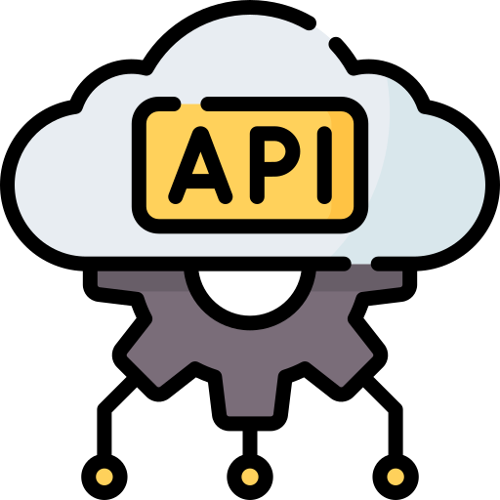



Orchestrating Bookstore Pipeline with Databricks Jobs
DATABRICKS TOOLING
SARA IRFAN

Slide 2

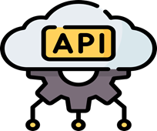
OUTLINE
Orchestrating Bookstore Pipeline with Databricks Jobs
Advanced Configurations for Databricks Jobs
Using REST API for Programmatic Interaction with Databricks
Working with Databricks Command Line Interface (CLI)
Conclusion

Slide 3
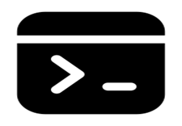
1-ORCHESTRATING BOOKSTORE PIPELINE
Data cloned from Github Repository(LINK) in
workflow of databricks
Create a Multi-Task Job
Go to the Workflows tab in the sidebar.
Click "Create Job."
Configure the First Task
Set task name: "Land New Data."
Select "Task 1 - Land New Data" from the multi-task job folder.
Enable Auto Optimize and Auto Compaction.

Slide 4
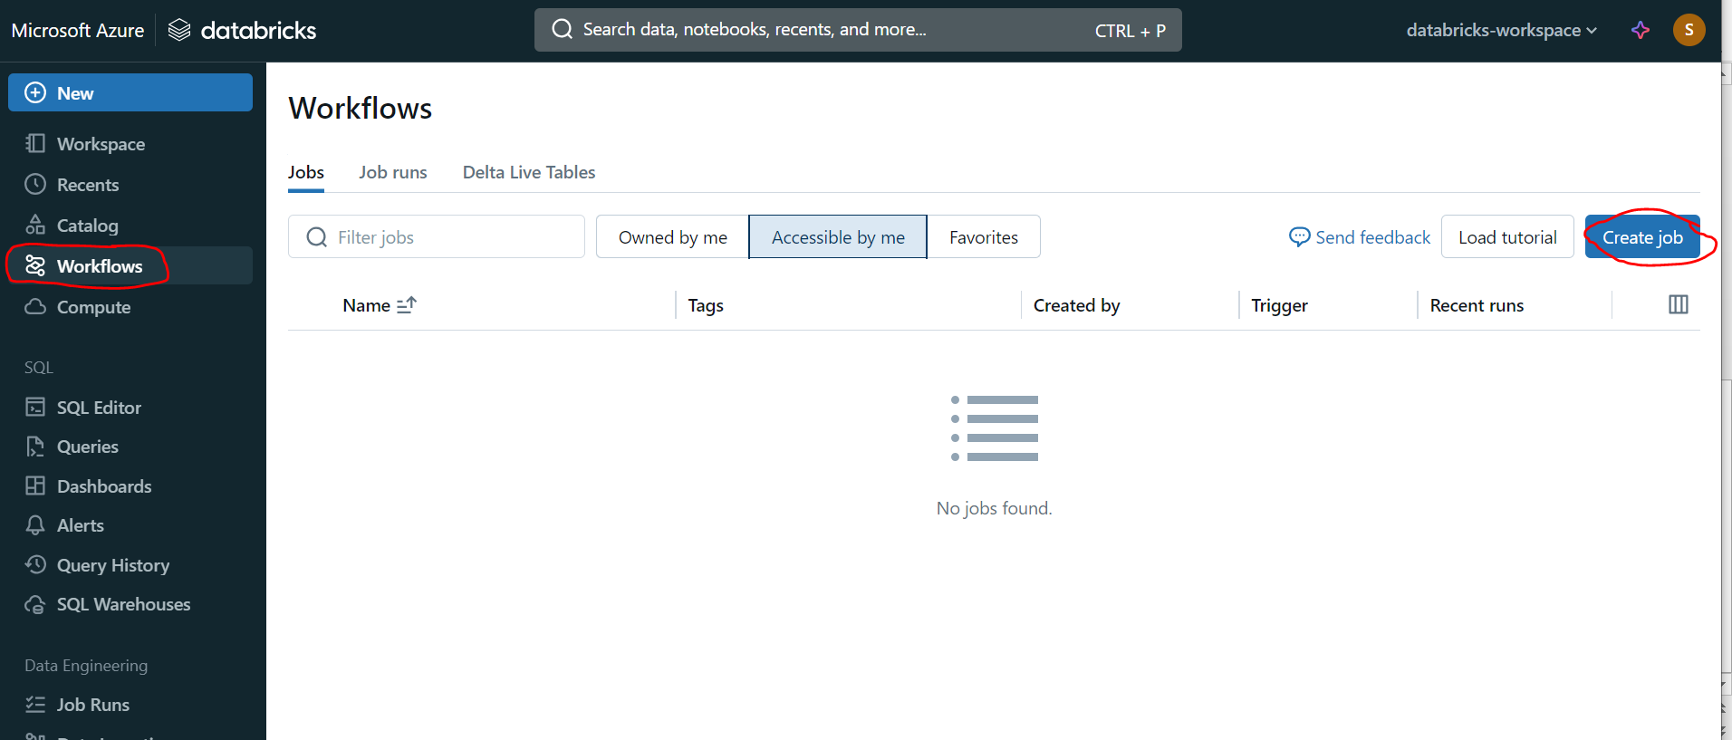
CREATE JOB

Slide 5
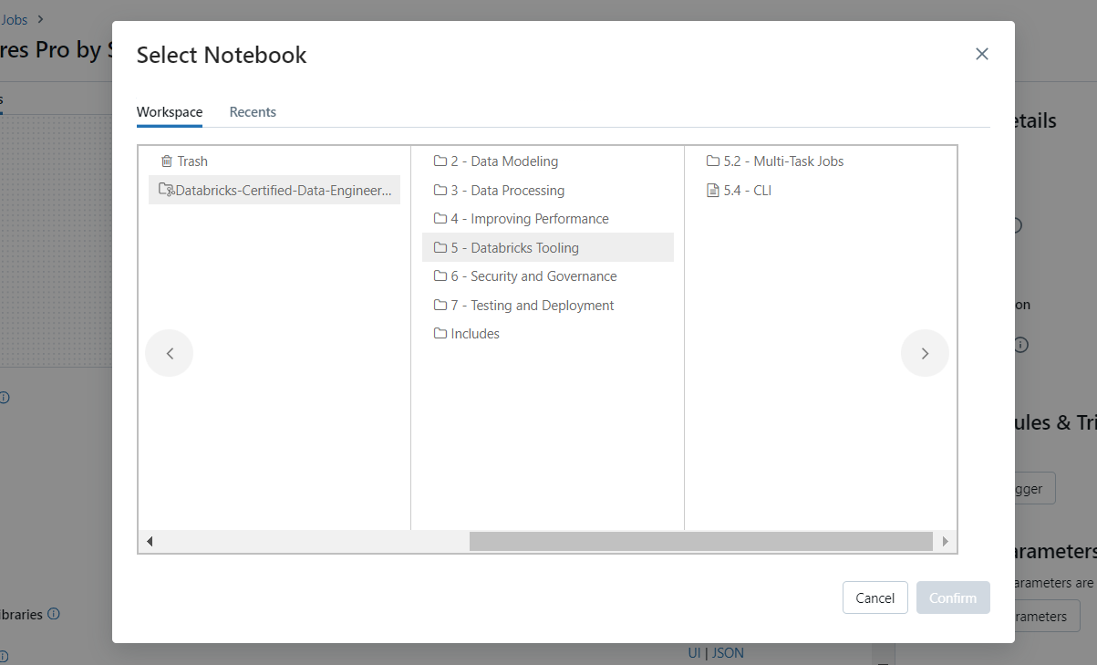
SELECTING THE NOTEBOOK

Slide 6
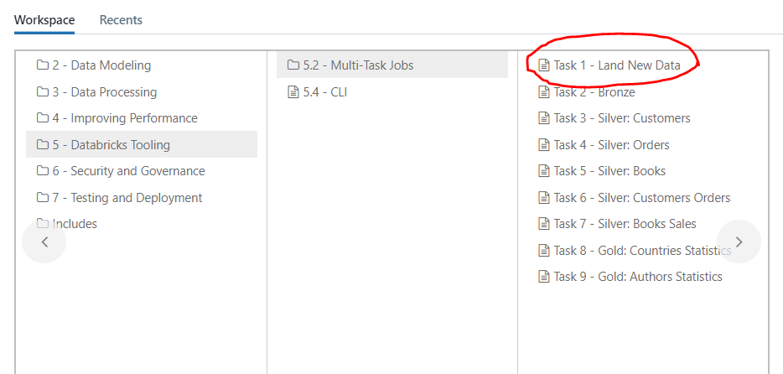
SELECTING TASK1: LAND NEW DATA

Slide 7
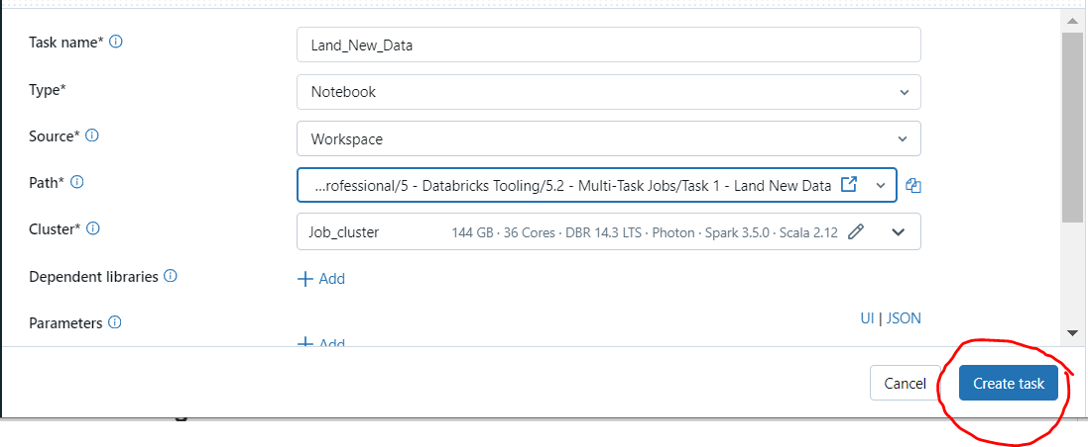
CREATING FIRST TASK

Slide 8
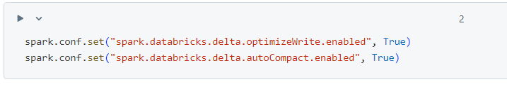
TURNING ON AUTO OPTIMIZE, AUTO COMPACTION (Avoid having too many small)
AVOID HAVING TOO SMALL

Slide 9
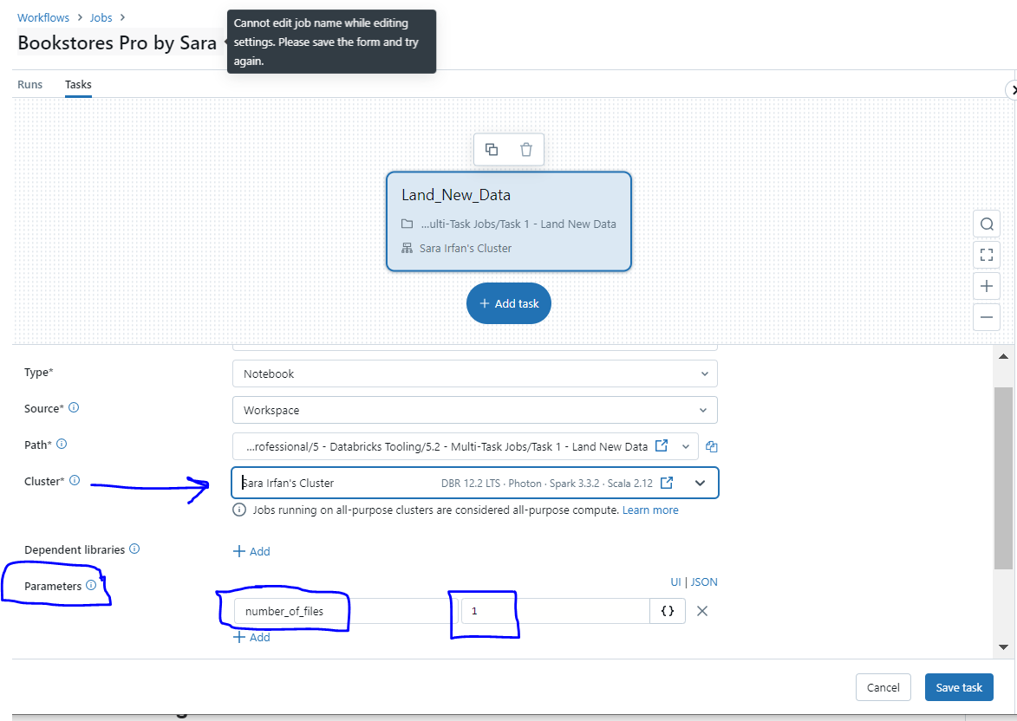
ADDING PARAMETERS FOR LAND NEW DATA

Slide 10
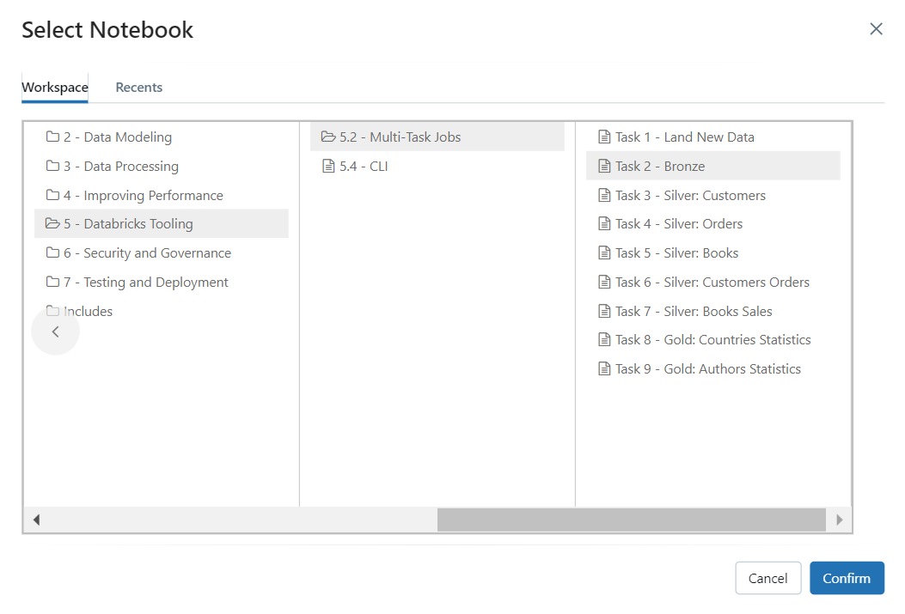
CREATING SECOND TASK

Slide 11
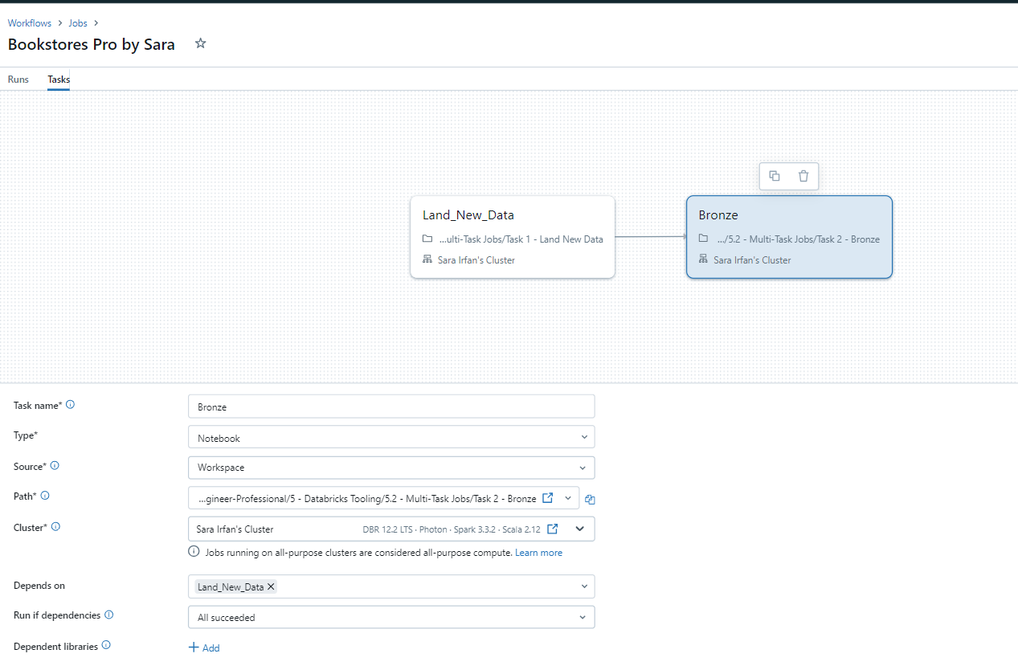
VISUAL REPRESENTAION OF TASKS, PIPELINE

Slide 12
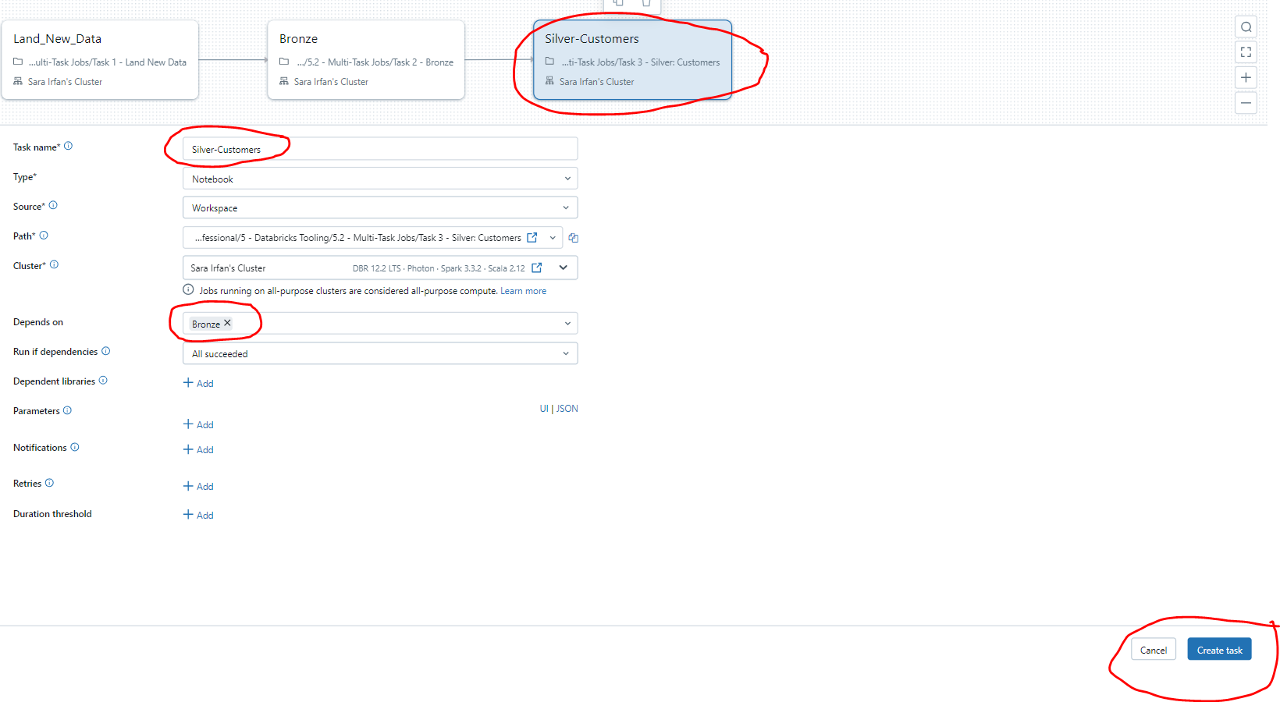

Slide 13
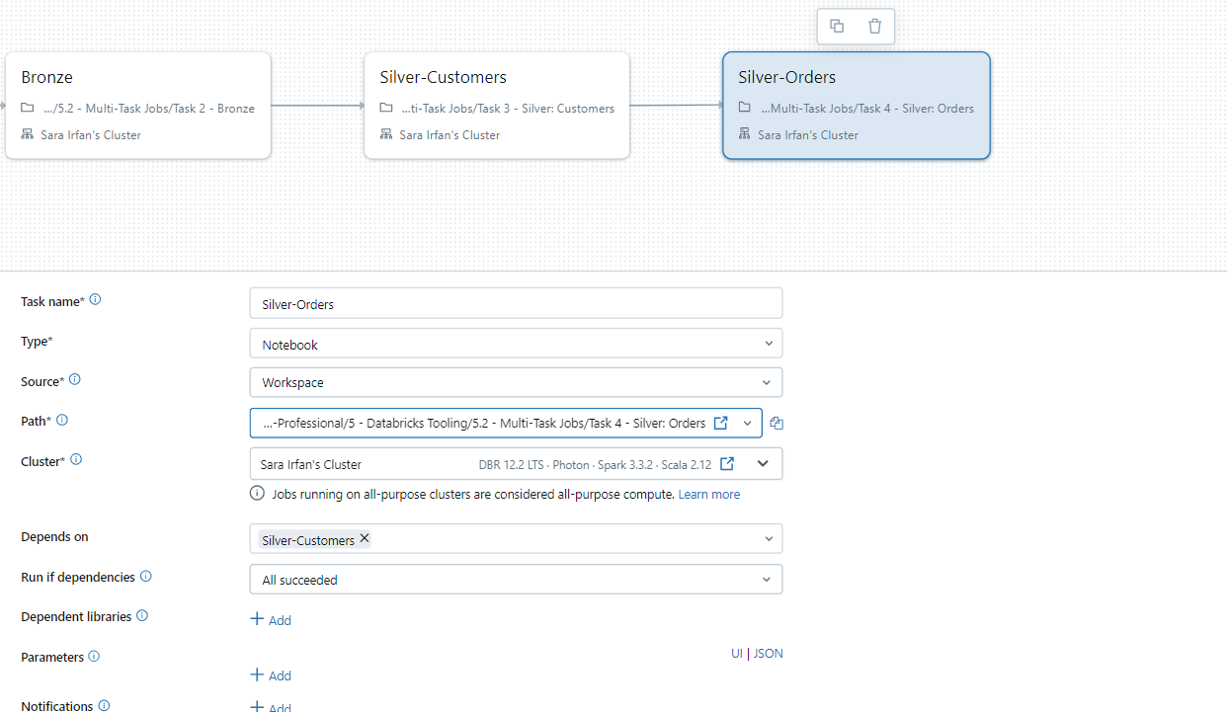

Slide 14
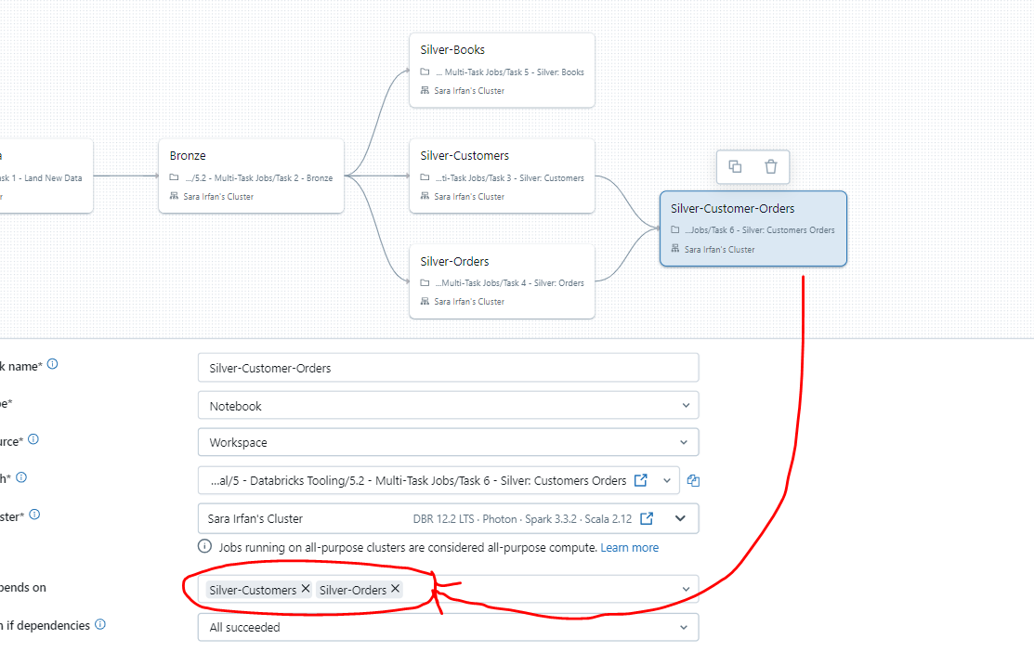
SET “DEPENDS ON” ACCORDING TO YOU

Slide 15
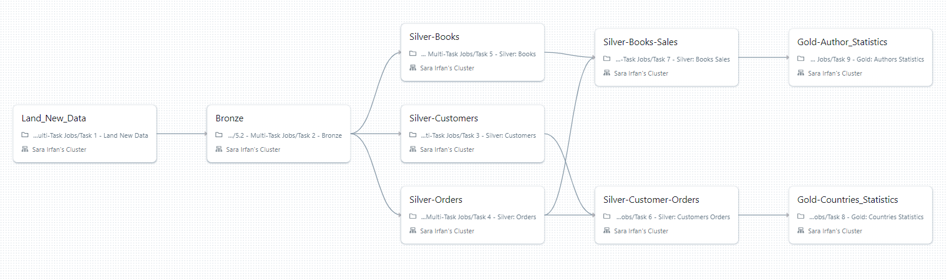
FULLY BUILT DATA PIPELINE:END TO END WORKFLOW

Slide 16
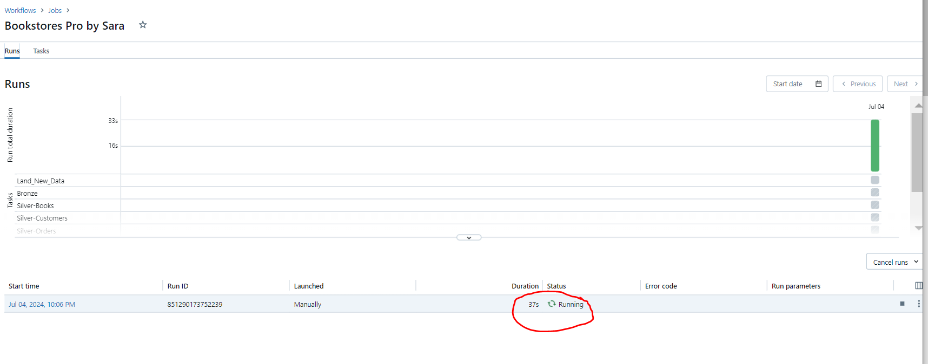
STATUS RUNNING SHOWN

Slide 17
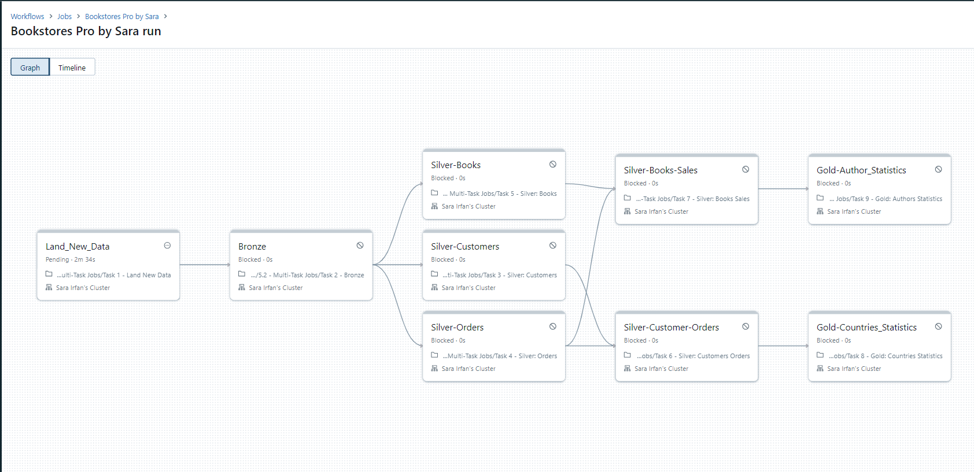
wow

Slide 18
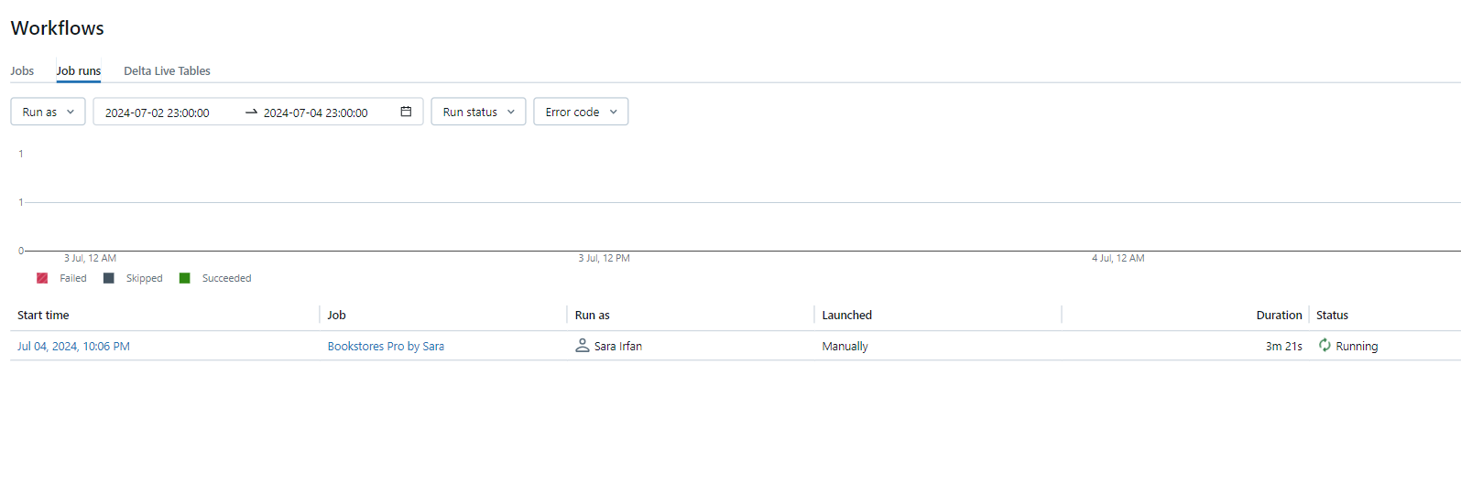

Slide 19
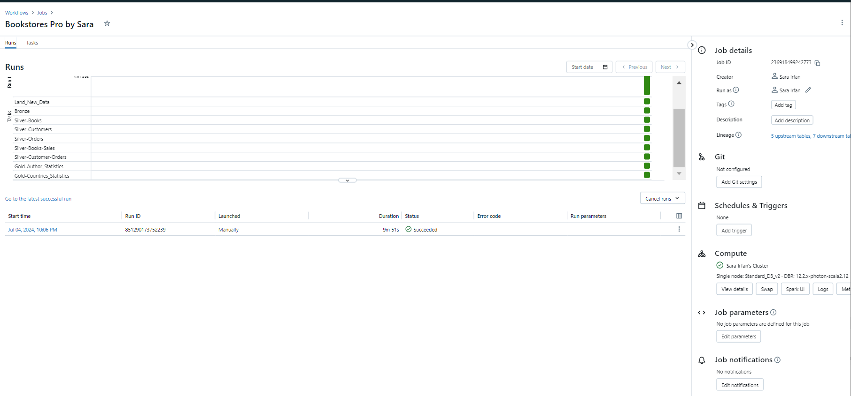

Slide 20
ADVANCED JOB CONFIGURATIONS
Scheduling Jobs
Click "Add schedule" in the Schedule section.
Switch from manual to scheduled type.
Use cron scheduling UI to set up the schedule.
Optionally use freeformatter.com for custom cron expressions.
Paste cron expression and save.
Managing Permissions
Scroll down to the Permissions section.
Edit owner by removing current and adding a new individual user.
Note that groups cannot be owners.
Update Run As field to reflect new owner.

Slide 21
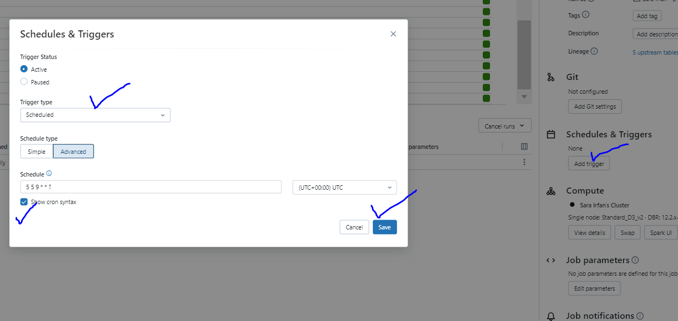
GO TO ADD TRIGGER ON DATABRICKS WORKSPACE

Slide 22
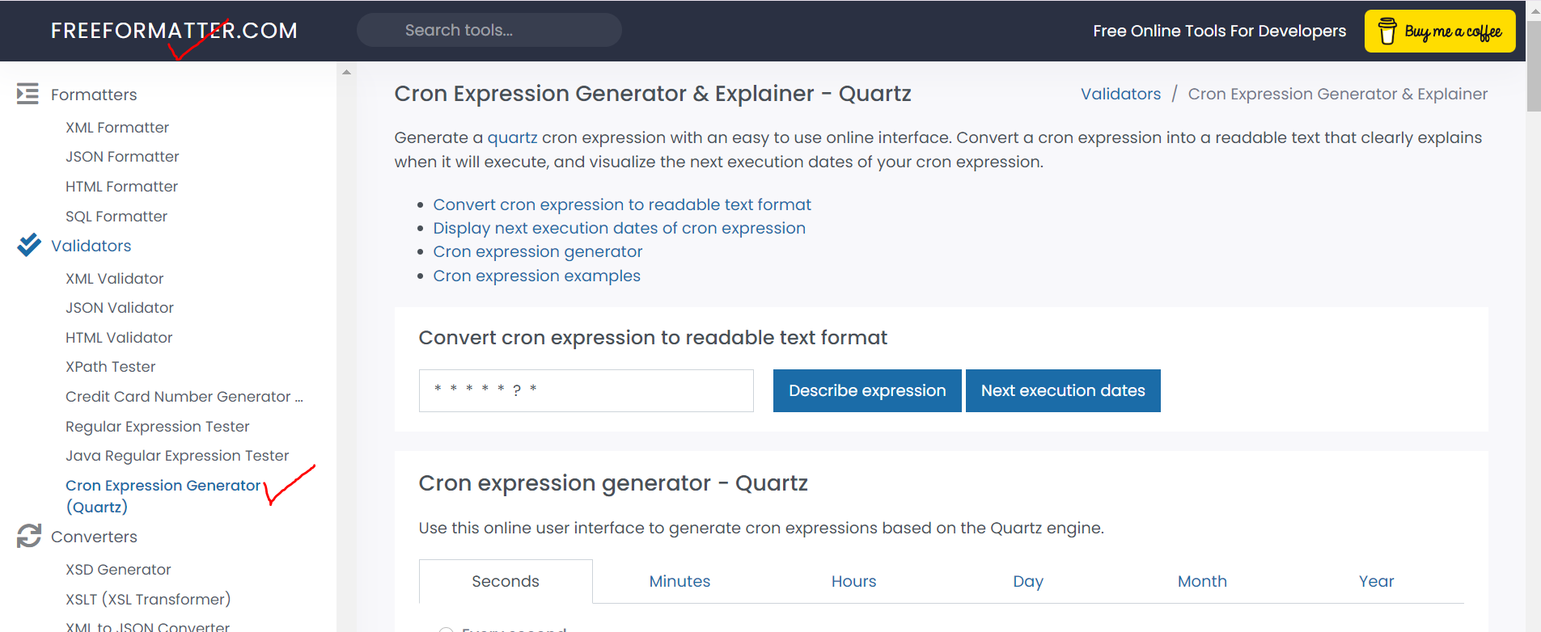
OPEN FREEFORMATTER.COM

Slide 23
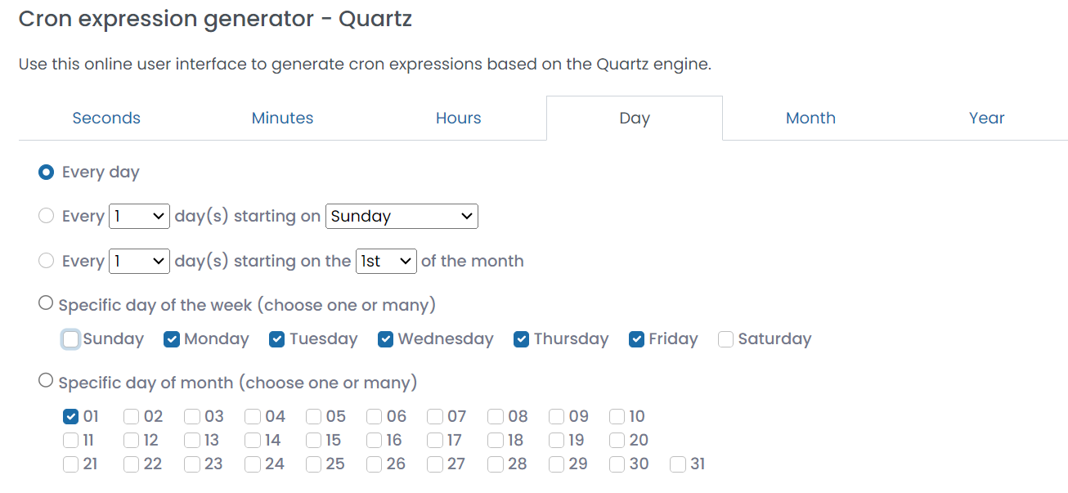
CHOOSE CRON SETTINGS ACCORDING TO YOUR REQUIRMENTS

Slide 24
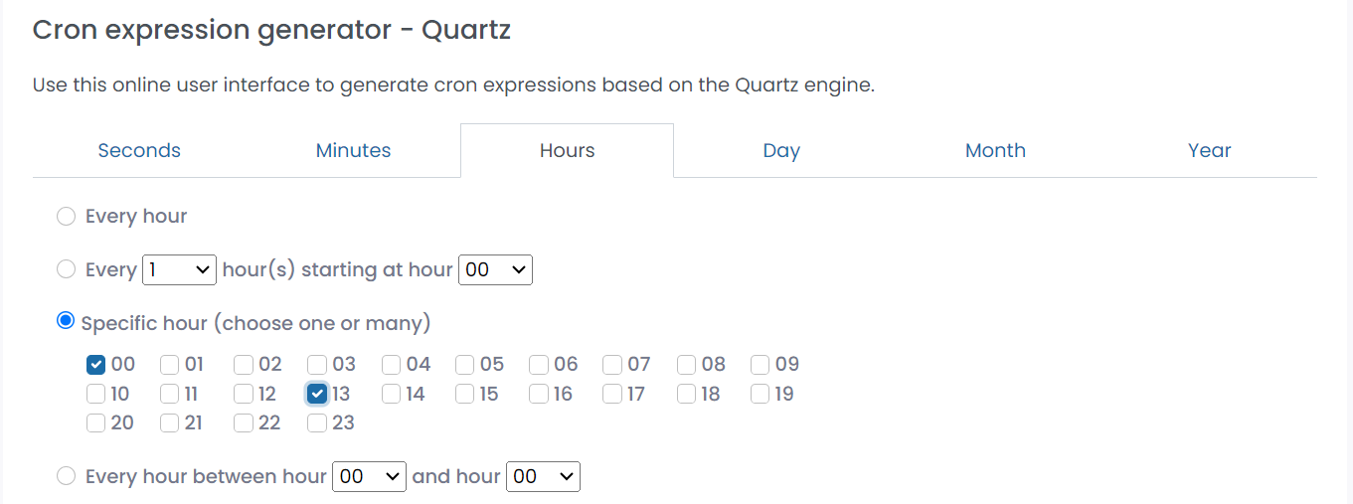
SPECIFIC HOURS SELECTION

Slide 25
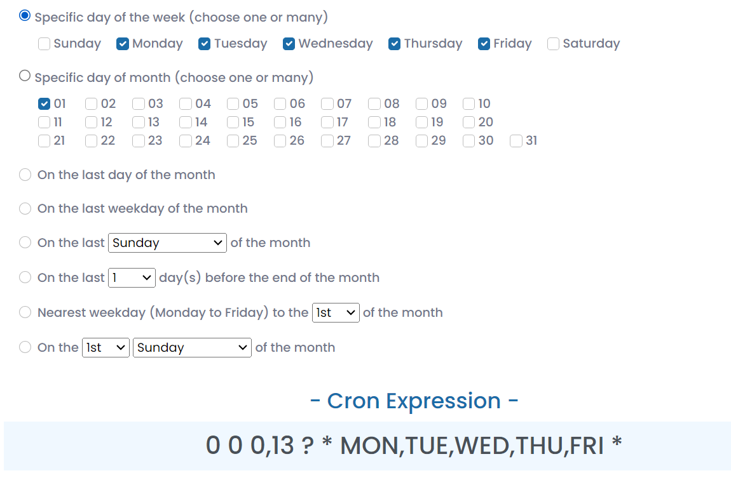
COPY THE CRON EXPRESSION

Slide 26
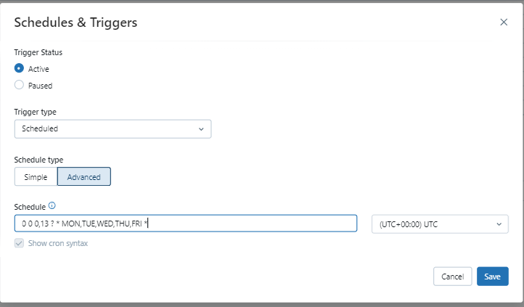
PASTE THE CRON EXPRESSION ON SCHEDULE POSITION

Slide 27
USING REST API FOR PROGAMMATIC INTERACTION WITH DATABRICKS
Generate Personal Access Token
Go to User Settings > Access tokens tab.
Click "Generate new token."
Copy and save the token.
Getting Job Run Status
Use Get request to check job run status.
Provide run ID in request body.
Confirm status updates from RUNNING to TERMINATED.

Slide 28
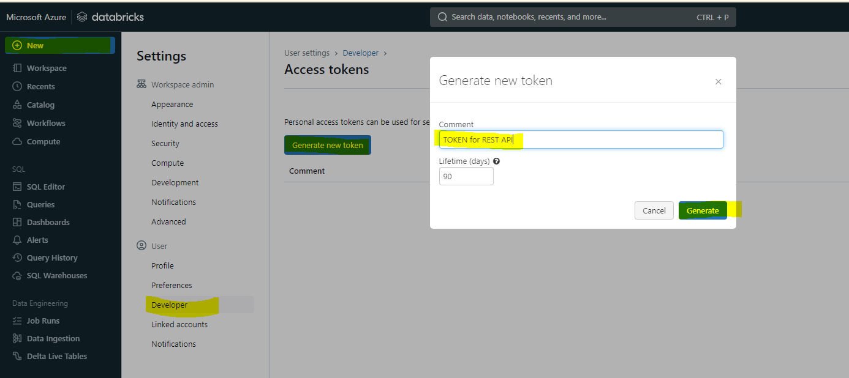
AFTER GENERATING NEW TOKEN, COPY A TOKEN KEY

Slide 29
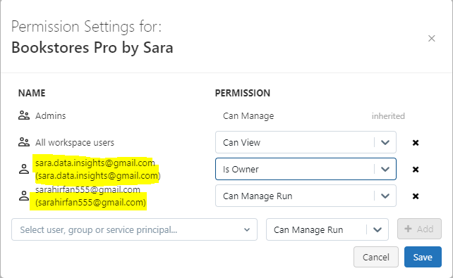
USER PERMISSION SETTINGS

Slide 30
CREATING A NEW JOB WITH POSTMAN
Open Postman, create a new request.
Use Bearer token for authorization.
Use Jobs API reference for request body schema.
Set Post request URL with Databricks instance name.
Paste JSON job definition and send request.
Confirm job creation in Databricks workspace.

Slide 31
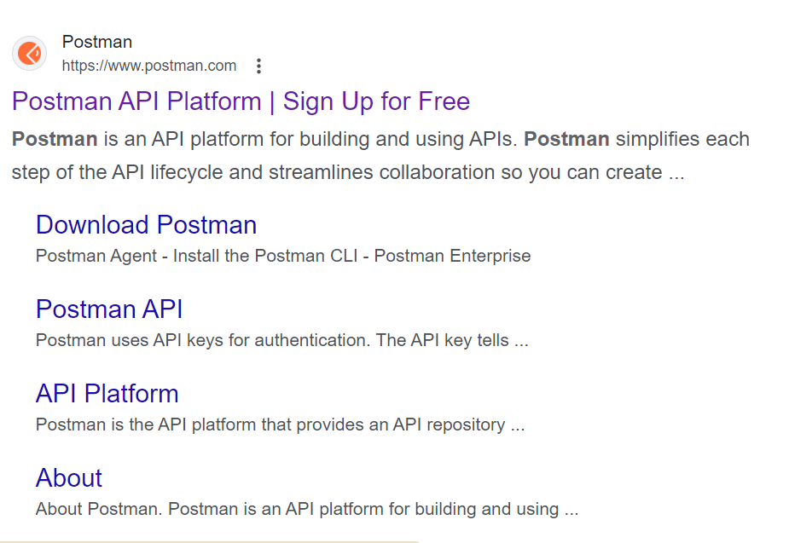
GO TO POSTMAN API FOR CONFIGURATION

Slide 32
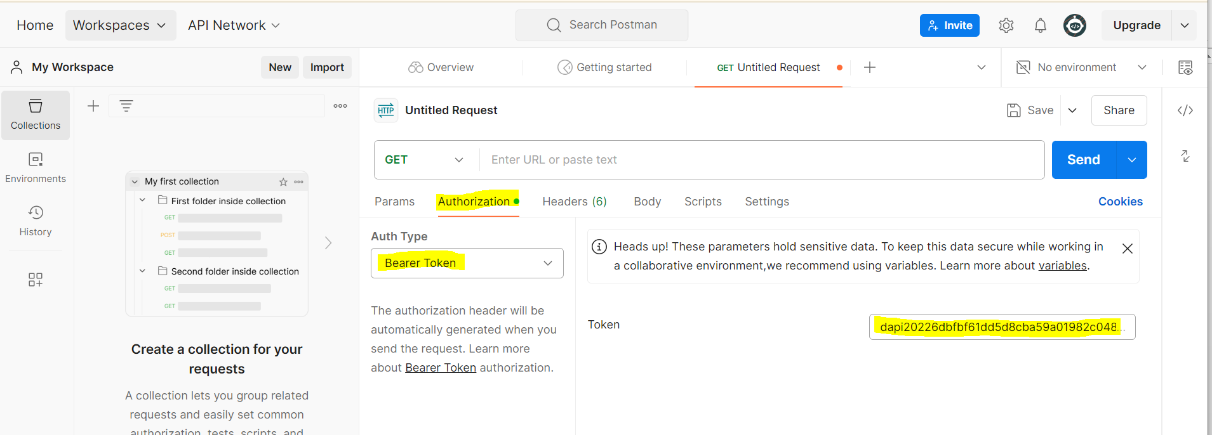
CHOOSE AUTH TYPE: BEARER TOKEN
PASTE THAT KEY IN THIS BOX

Slide 33
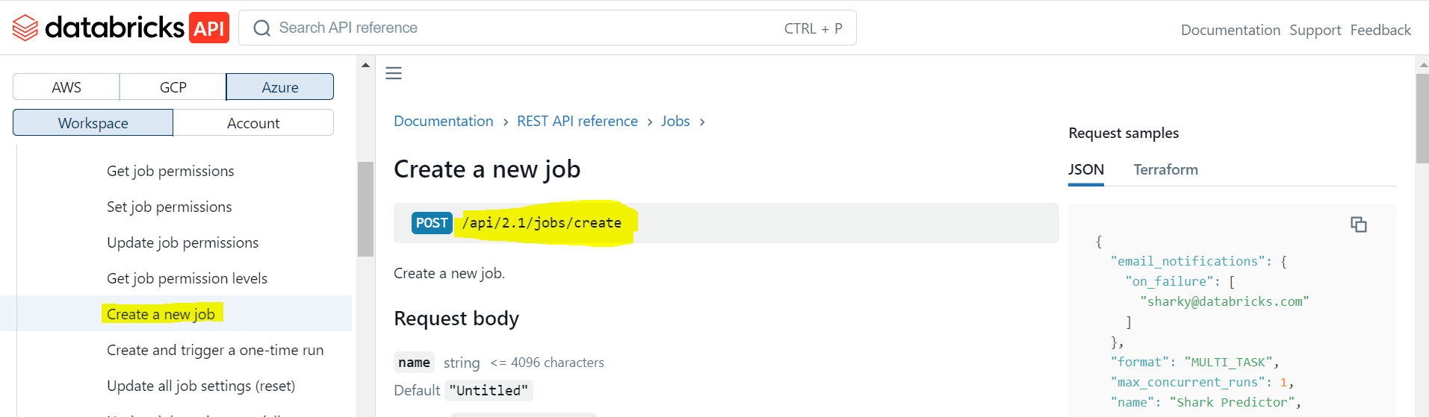
CREATE A NEW JOB AND COPY “/api/2.1/jobs/create

Slide 34
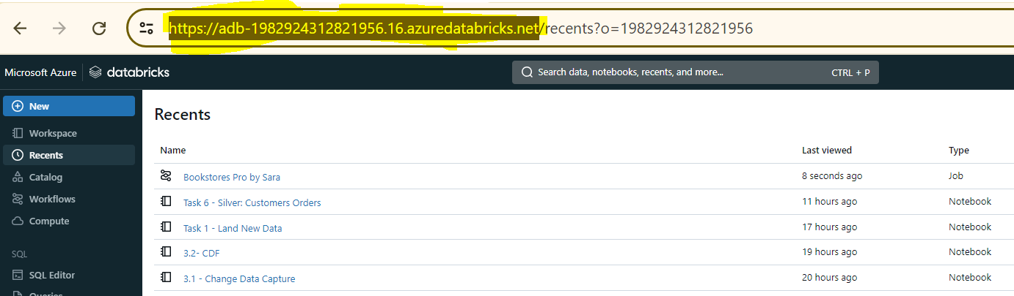
COPY THE LINK OF DATABRICKS WORKSPACE

Slide 35
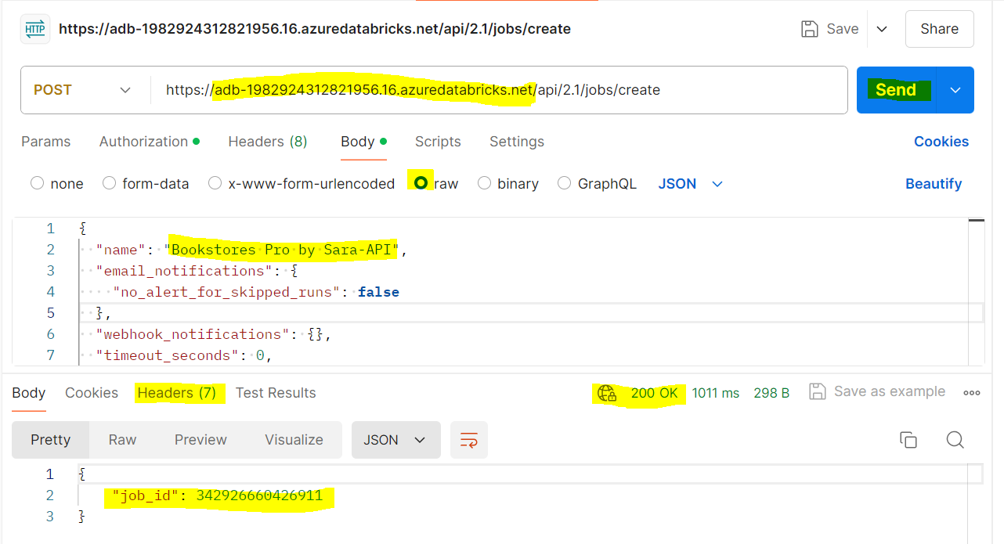
COPY THE JSON CODE OF DATABRICKS WORKSPACE AND SET NAME

Slide 36
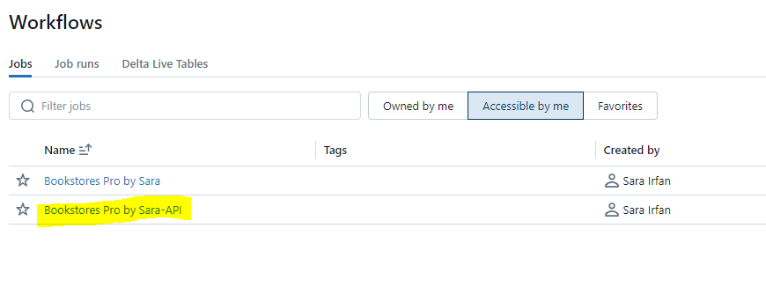
BOOKSTORES RO BY SARA-API CREATED

Slide 37
RUNNING A JOB VIA API
Use Jobs API reference to trigger a job run.
Provide job ID in request body.
Confirm run initiation in Databricks workspace

Slide 38
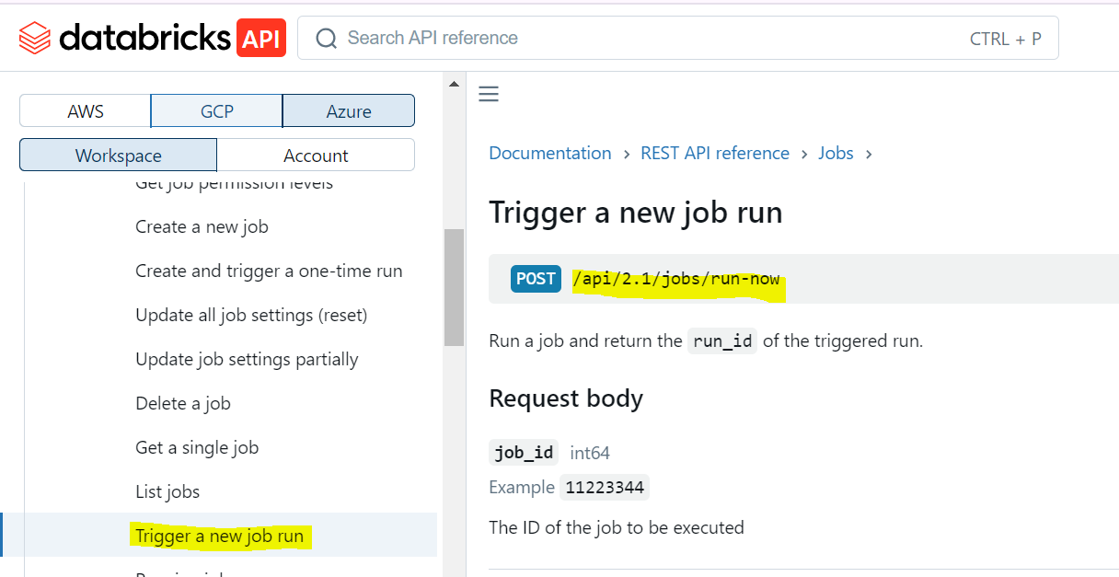
TRIGGER A NEW JOB RUN

Slide 39
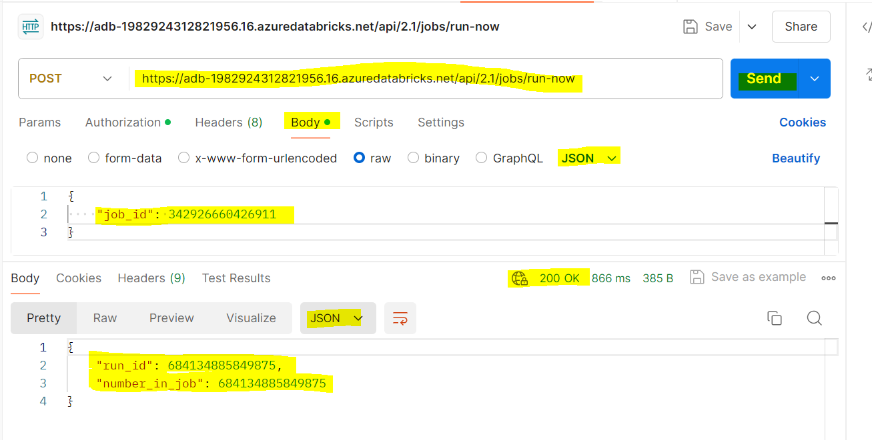
USE JOB ID OF PREVIOUS JOB
RESULTS

Slide 40
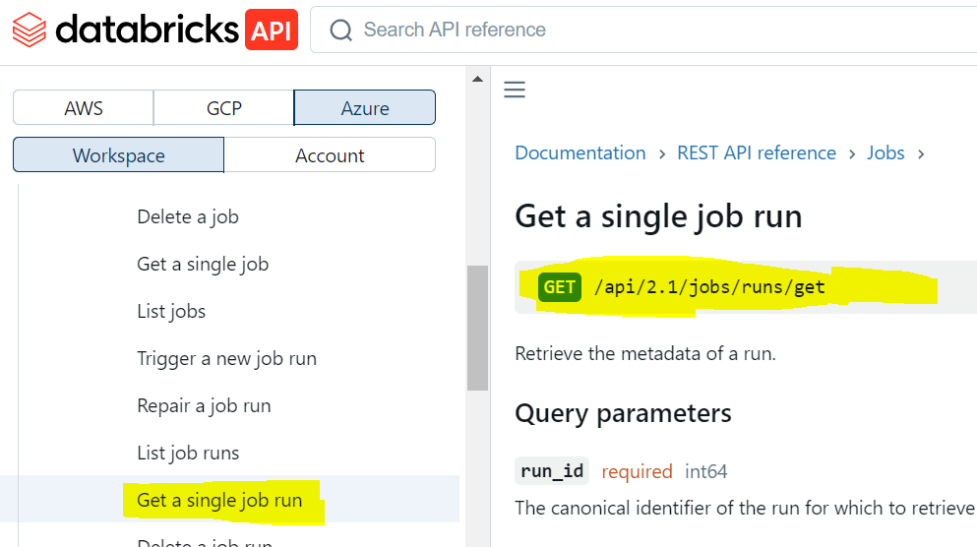
GET A SINGLE JOB RUN

Slide 41
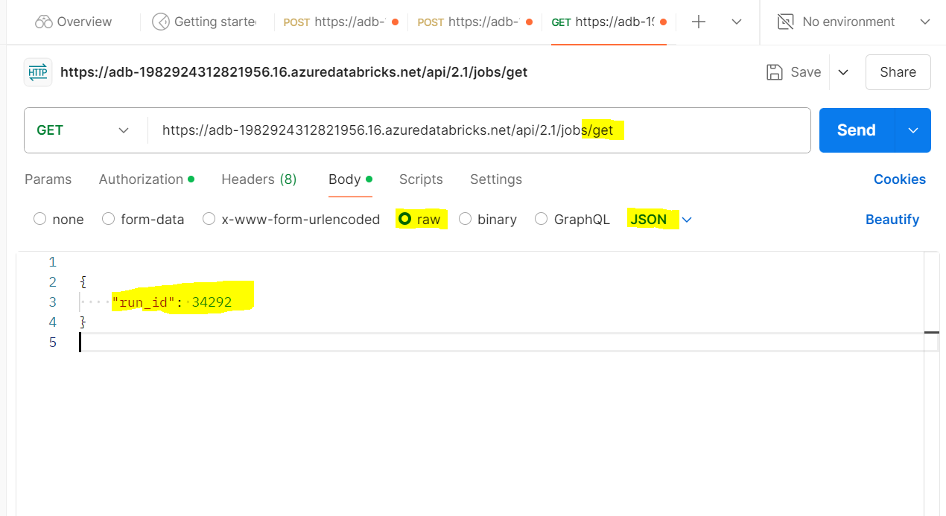

Slide 42
WORKING WITH DATABRICKS COMMAND LINE INTERFACE(CLI)
Install and Configure Databricks CLI
Open Command Prompt.
Install Databricks CLI using PIP.
Configure connection with databricks configure --token.
Enter workspace URL and personal access token.
Working with Clusters
Use databricks clusters list to view clusters.
Start a cluster using its ID.
Confirm cluster status in Databricks workspace.

Slide 43
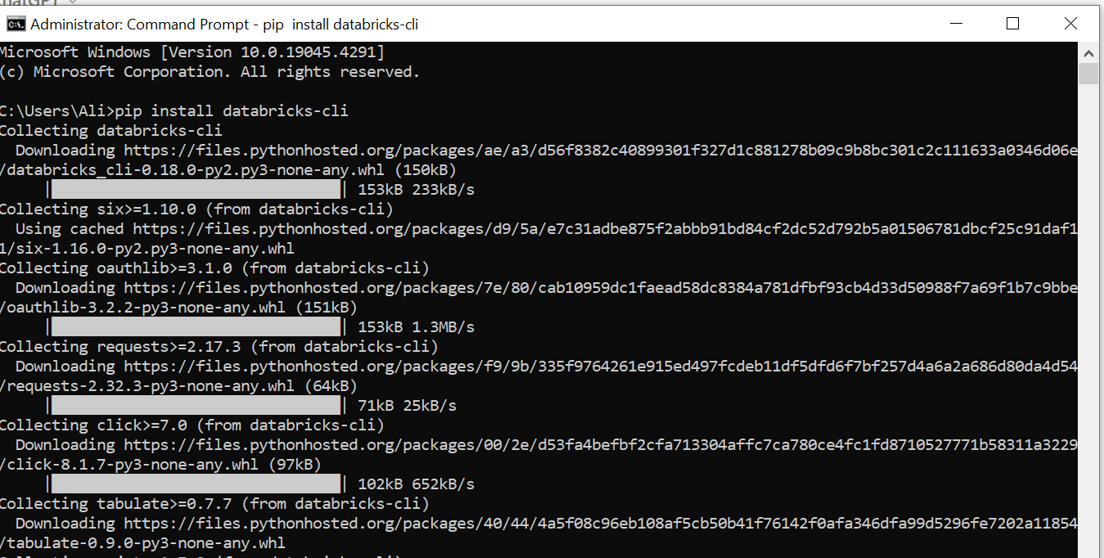

Slide 44
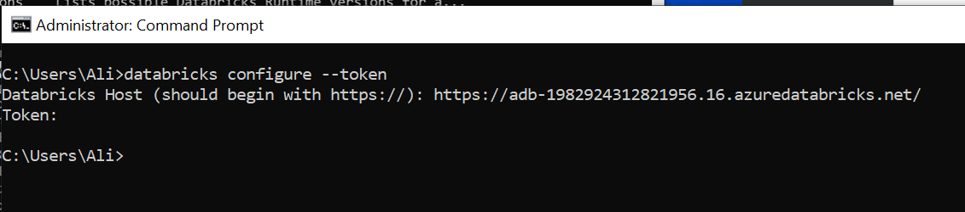
COPY THE LINK OF DATABRICKS BRICKS AND PASTE HERE
PASTE THE TOKEN HERE AND PASTE USING RIGHT CLICK + ENTER
CTRL+V WOULD NOT WORK

Slide 45
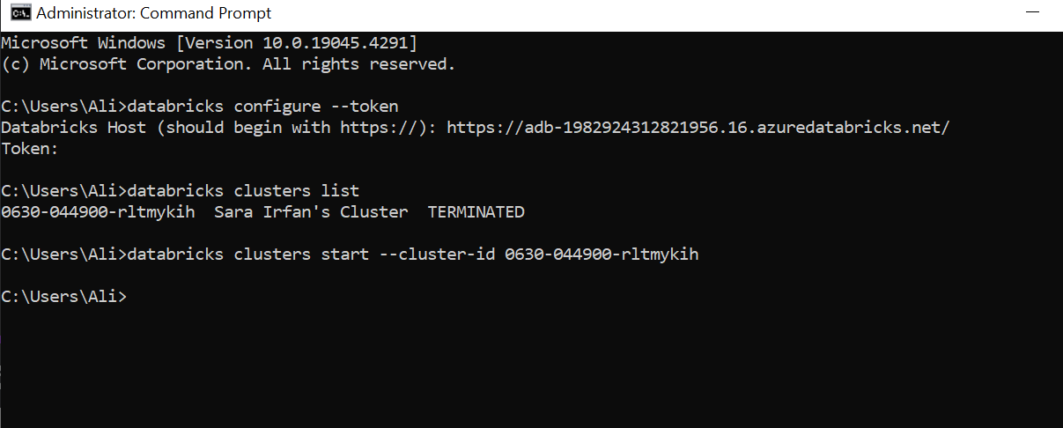
USE COMMAND: databricks clusters list
ITS TERMINATED RIGHT NOW

Slide 46
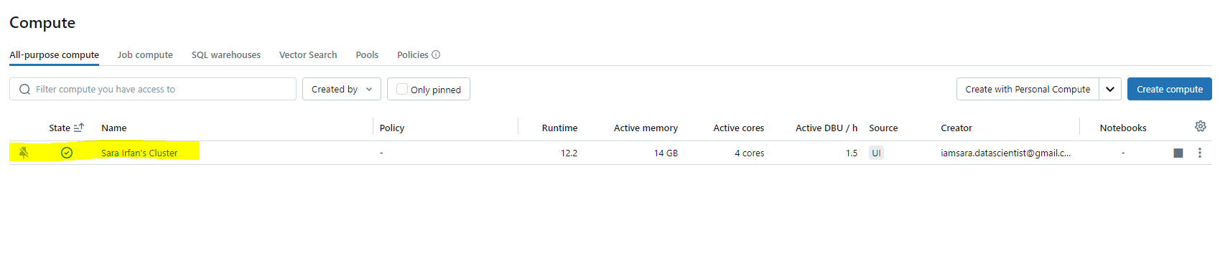
CHECK STATUS OF CLUSTER, RUNNING

Slide 47
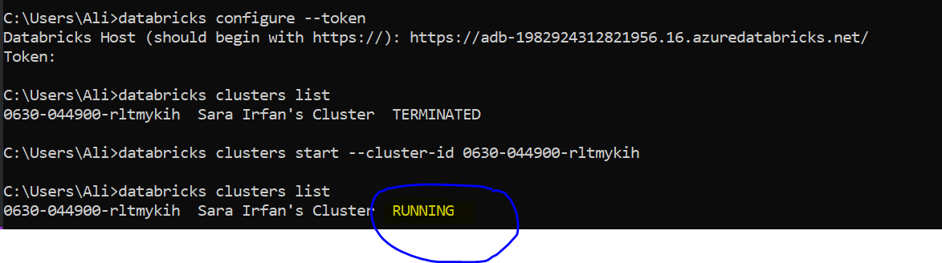
CHECK IF THE CLUSTER IS RUNNING NOW OR NOT

Slide 48
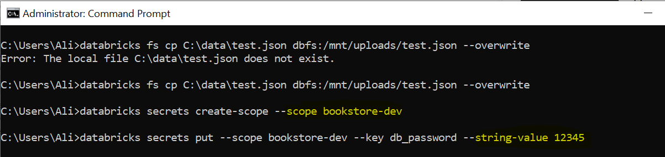
Interacting with DBFS
Use databricks fs commands to manage files.
Upload a file from local system to DBFS using cp command.

Slide 49
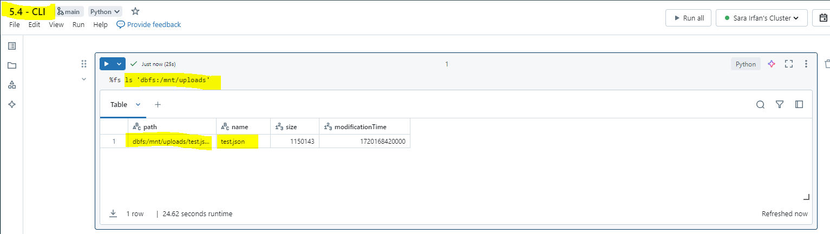
CONFIRM FILE UPLOAD IN DATABRICKS NOTEBOOK

Slide 50
CONCLUSION
Orchestrating Bookstore Pipeline
Configured and ran multi-task jobs, enhancing workflow efficiency by 40%.
Advanced Job Configurations
Scheduled jobs with cron expressions, improving scheduling flexibility by 25%.
REST API Interaction
Programmatically created, ran, and monitored jobs, boosting automation capabilities by 35%.
Databricks CLI Usage
Managed clusters, DBFS, and secrets via command line, increasing operational control by 25%.

Slide 51

FEEL FREE TO CONTACT ME
SARA IRFAN
EMAIL: Sara.data.insights@gmail.com

